Slide 1
The Importance of Health Policy Analysis: “Why its Important...why Tribes, Area Health Boards & National Indian Organizations need to figure out how to fund it”
Jim Roberts, Policy Analyst
Northwest Portland Area Indian Health Board
September 22, 2015

Slide 2
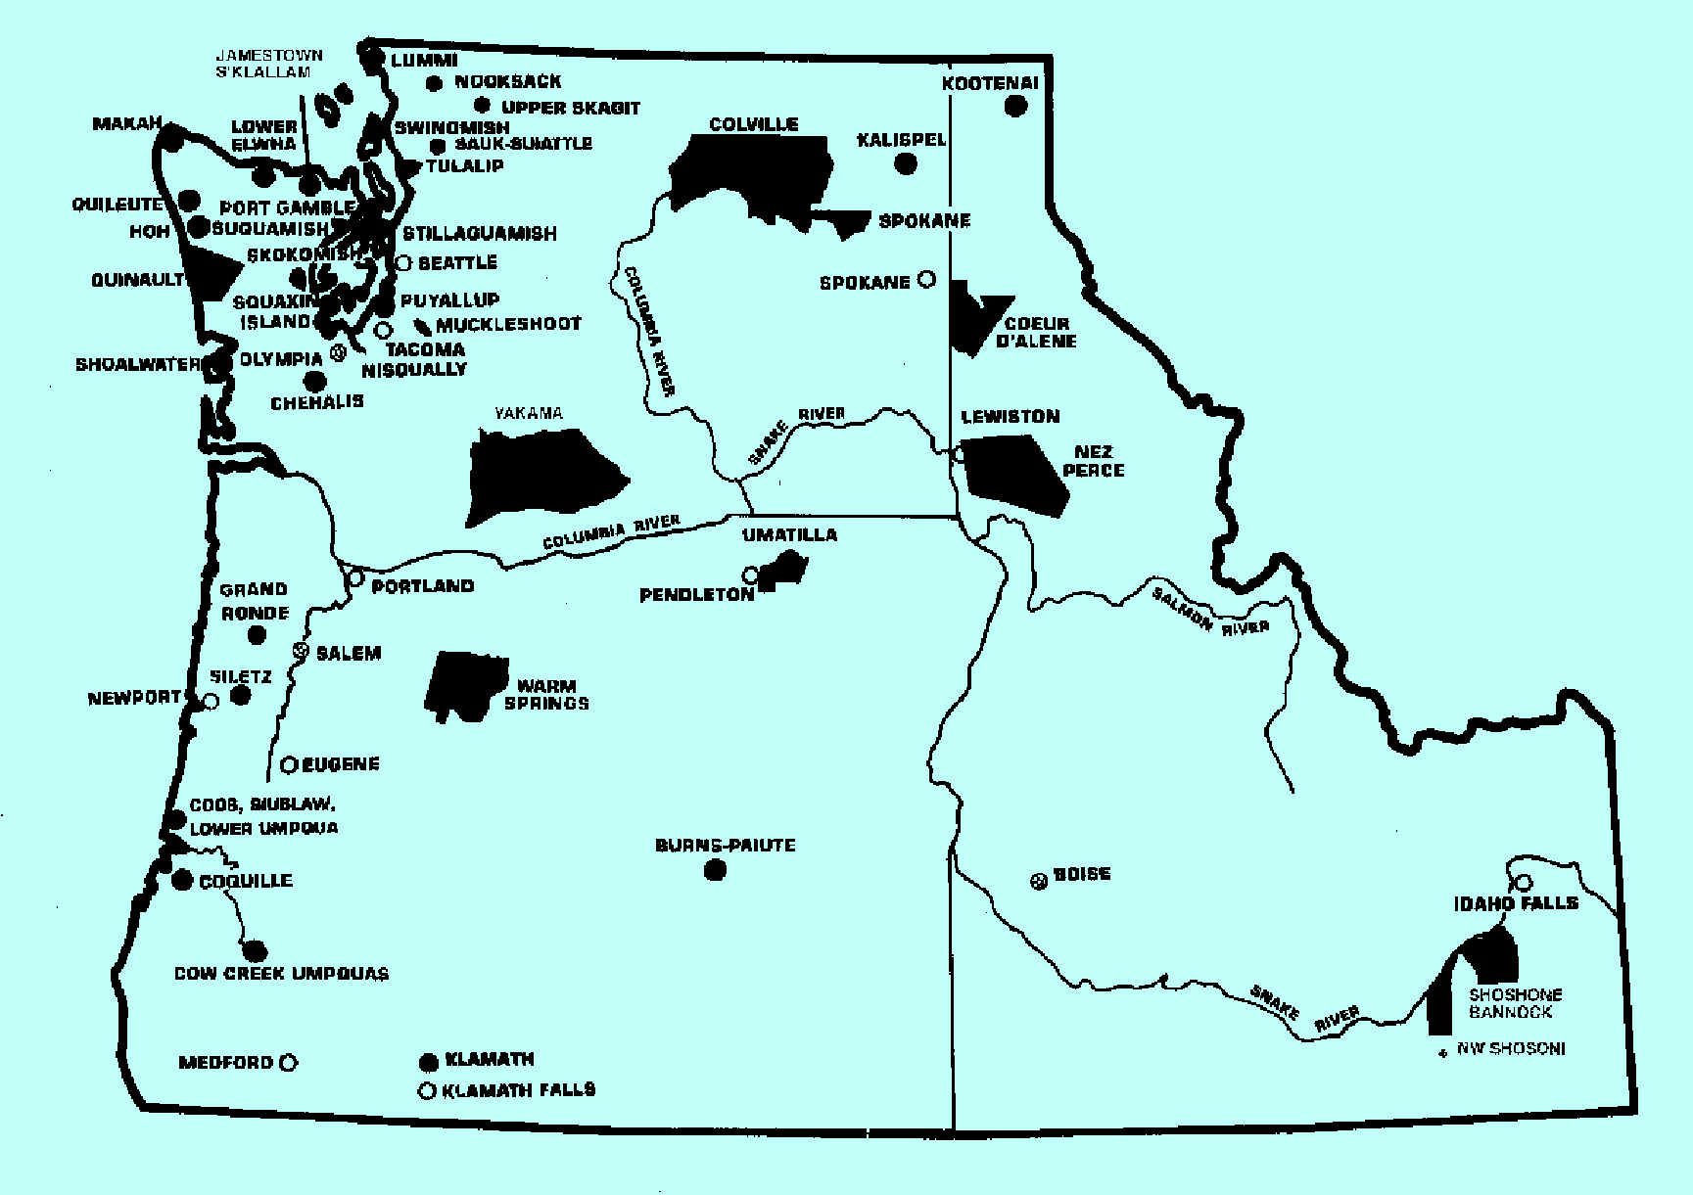
About NPAIHB & our Mission
Established in 1972 to assist Northwest Tribes to improve the health status and quality of life of member tribes and Indian people in their delivery of culturally appropriate and holistic health care

Slide 3
About the Northwest Portland Indian Health Board
Northwest Tribes have long recognized the need to exercise control over the design, development, and management of their health care delivery systems
In 1972, Northwest Tribes organized NPAIHB to represent Portland Area Tribes serve as a liaison and advocate Tribal issues and concerns with IHS resources and program services
NPAIHB role has evolved over the years from a liaison and advocate to an intermediary to facilitate Tribal assumption of Indian health programs under Self-Determination and Self-Governance
An evolving relationship with IHS, Tribal government, and Indian health programs
In this 43 year history a cornerstone of the work at NPAIHB has been its ability to conduct health policy analysis

Slide 4
Indian Policy: “Where does it begin?”
Legislation
Regulations
Administrative Decisions
Agency Implementation
Program Implementation/Services

Slide 5
Evolution of Policy Analysis
Until 1980’s, few would have carried a title of “Policy Analysis”
Many policy analytics performed by lawyer, economists, planners, program evaluators, budget analysts, researchers or statisticians
Over the last 40 years Policy Analysis is an established profession
Policy Analysts are more common in government agencies and often filled by people trained in public administration, lawyers, or specifically as analysts
Perception is that Indian health program have not kept pace with this evolution and is evident in lack of individuals working in Indian health policy
This is clear when one looks at the number of Indian people working on NIHB’s Medicare & Medicaid Policy Committee

Slide 6
Why is Policy Analysis Important?
“It is the single most important function that will support the development, financing, and preservation of our Indian health system and the trust responsibility to provide health care to our American Indian and Alaska Native people”
“The ACA has changed the landscape and the future of health care financing will be at the State level in Medicaid and health insurance marketplaces”

Slide 7
NPAIHB Strategic Plan Priorities
Indian Health Policy
Build & Maintain A Strong Organization to Support Tribes
Support health, education promotion, disease and prevention
Epi-Centers: support culturally appropriate health research and surveillance
Strengthen regional and national partnerships to ensure access to best possible health

Slide 8
NPAIHB Policy Work ...how we do it?
Executive Director: Public Health and CDC/NIH
Policy Analyst: State health policy, CMS, IHS, SAMHSA, other HHS programs
EpiCenter Director: Federal and state public health, NIH, CDC, and other HHS Programs
NPAIHB Program Directors: Everyone does policy work in some form or another
Portland Area Tribal Health Directors
Lobbying and Policy Analysis Budget supported by Portland Area Tribal health programs
NPAIHB also hires subject matter experts and attorneys

Slide 9
NPAIHB Policy Analyst Responsibilities
Tribal Advisory Committees and Consultation: staff and provide technical support to Tribal Leaders
Participate in IHS, HHS, State Advisory Committees
Facilitate State and federal Tribal consultation
Coordinate, conduct, and participate in State/Tribal Meetings
Idaho State/Tribes Meetings, Tribal Exchange Meetings
Oregon SB 770, Medicaid Billing, and OHA Quarterly Consultation, Insurance Commissioner Exchange Meetings
Washington Medicaid Tribal Meetings, Centennial Accord, Consultation AIHC Quarterly Meetings, OIC Meetings, WA-HBE Tribal Meetings

Slide 10
IHS Workgroup meetings
Contract Support Costs Workgroup
CHS/PRC Workgroup
Facilities Appropriations Advisory Board (FAAB)
FDI/Data Workgroup (LNF)
Tribal Leaders Diabetes Committee
IHS National Budget Formulation Workgroup
Portland Area Fund Distribution Workgroup
Portland Area Facilities Advisory Committee

Slide 11
HHS Workgroups
Executive Director:
CDC Tribal Consultation Advisory Committee (TCAC)
NIH Tribal Advisory Committee
Policy Analyst
IHS Advisory Committees
HHS Secretary’s Tribal Advisory Committee (STAC)
CMS Tribal Technical Advisory Group (TTAG)
Other HHS Op-Div Tribal Consultation sessions
State Medicaid Agencies
EpiCenter Director
SAMHSA Tribal Advisory Committee (TAC)
Health Research Advisory Committee (HRAC)
HRSA Tribal Consultation

Slide 12
NPAIHB Policy Accomplishments
Northwest Tribes have entity to provide legislative, budget, regulatory, and administrative, and programmatic expertise on issues
If we don’t have it, we’ll hire it...importance of Tribes supporting the work and their expectations!
Long-standing recognition at federal and state level of showing up and having expertise on issues
Recognized State-Tribal relationships for policy making with many positive outcomes
Established Policy Briefs, Newsletters, legal memorandum, and budget analysis

Slide 13
NPAIHB and Policy Examples/Outcomes
NPAIHB Annual Budget Analysis Report
Policy Briefs, Position Papers, Legal Analysis
Establishment of AIHC of Washington State
Institutionalized State/Tribes Meetings
Red & Blue Books Policy Manuals on Contract Support Costs
Health Reform, Medicaid Reform, & CSC Summits (partnerships with Kaiser Family Foundation & Urban Institute)
Amendments to the IHCIA
DRA and MMA Indian amendments
ACA Indian specific provisions
Tribal EpiCenter legislation and funding
Washington State/AIHC: “American Indian Health Delivery Plan”
“AI/AN Community Health Profiles” (ID, WA, OR)
“State Tribal Health Policymaking in Oregon, Washington and Idaho: Institution Building for Health Care Policymaking”

Slide 14
In Closing
“It is the single most important function that will support the development, financing, and preservation of our Indian health system and the trust responsibility to provide health care to our American Indian and Alaska Native people”

